Slide 1
Introduction to DevOps
Sonika Rathi
Assistant Professor
BITS Pilani

Slide 2
Agenda
Managing Dependency Problems
Common dependency problem with libraries at run time
Managing Libraries
Managing Component
Managing Dependency Graphs

Slide 3
Dependency Problems
Common dependency problem with libraries at run time
Dependency Hell also refer as DLL Hell
Occurs when an application depends upon one particular version of something, but is deployed with a different version, or with nothing at all
DLL hell was common problem in earlier versions of Windows,
as all shared libraries (DLLs), stored in a system directory (windows\system32) without any versioning; new versions would simply overwrite old ones
In versions of Windows prior to XP the COM class table was a singleton, so applications that required a particular COM object would be given whichever version had been loaded ﬁrst

Slide 4
Dependency Problems
Common dependency problem with libraries at run time contd..
The introduction of the .NET framework resolves the DLL hell problem by introducing the concept of assemblies that allow different versions of the same library to be distinguished
Linux avoids dependency hell by using a simple naming convention: It appends an integer to every .so ﬁle in the global library directory (/usr/lib), and uses a soft link to determine the canonical system-wide version

Slide 5
Managing Libraries
Implementing Version Control
One is to check them into version control
Is the simplest solution, and will work ﬁne for small projects
a lib directory is created in your project’s root to put libraries and by adding three further subdirectories: build, test, and run—for build-time, test-time, and runtime dependencies
using a naming convention for libraries that includes their version number; you know exactly which versions you’re using
Benefit:
Everything you need to build your application is in version control
Once you have a local check-out of the project repository, you know you can repeatably build the same packages that everybody else has
Problems:
your checked-in library repository may become large and it may become hard to know which of these libraries are still being used by your application
Another problem crops up if your project must run with other projects on the same platform
Manually managing transitive dependencies across projects rapidly becomes painful

Slide 6
Managing Libraries
Automated
Another solution is to declare libraries and use a tool like Maven or Ivy to download libraries from Internet repositories or (preferably) your organization’s own artifact repository [Automated]

Slide 7
Managing Component
Overview
Almost all modern software systems consist of a collection of components
These components may be DLLs, JAR files, OSGi bundles, Perl modules, or something else
Components have a relatively long history in the software industry

Slide 8
Managing Component
Components make development processes efficient
They divide the problem into smaller and more expressive chunks
Components often represent differences in the rates of change of different parts of the system, and have different lifecycles
They encourage us to design and maintain software with clear description of responsibilities, which in turn limits the impact of change, and makes understanding and changing the codebase easier
They can provide us with additional degrees of freedom in optimizing our build and deployment process

Slide 9
Managing Component
Components to be separated from Codebase
Part of your codebase needs to be deployed independently (for example, a server or a rich client)
You want to turn a monolithic codebase into a core and a set of plugins, perhaps to replace some part of your system with an alternative implementation, or to provide user extensibility
The component provides an interface to another system (for example a framework or a service which provides an API)
It takes too long to compile and link the code
It takes too long to open the project in the development environment
Your codebase is too large to be worked on by a single team

Slide 10
Managing Component
Pipelining Components
Split your system into several different pipelines
Parts of your application that have a different lifecycle (perhaps you build your own version of an OS kernel as part of your application, but you only need to do this once every few weeks)
Functionally separate areas of your application that are worked on by different (perhaps distributed) teams may have components speciﬁc to those teams
Components that use different technologies or build processes
Shared components that are used by several other projects
Components that are relatively stable and do not change frequently
It takes too long to build your application, and creating builds for each component will be faster

Slide 11
Managing Component
Pipelining Components
The build for each component or set of components should have its own pipeline to prove that it is ﬁt for release
This pipeline will perform the following steps
Compile the code, if necessary
Assemble one or more binaries that are capable of deployment to any environment
Run unit tests
Run acceptance tests
Support manual testing, where appropriate

Slide 12
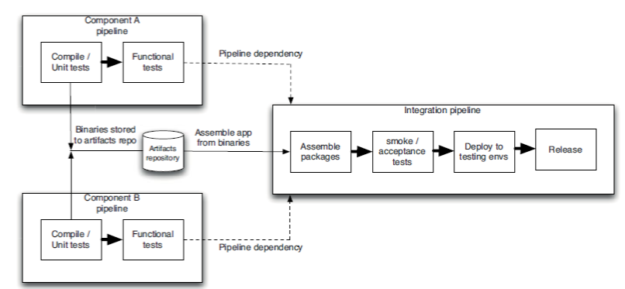
Managing Component
Integration Pipeline

Slide 13
Managing Component
Managing Dependency Graphs
Having set of components, each with their own pipeline, feeding into an integration pipeline which assembles the application and runs automated and manual tests on the ﬁnal application
However, things are often not quite this simple:
Components can have dependencies on other components, including third-party libraries
If you draw a diagram of the dependencies between components, it should be a directed acyclic graph (DAG)
If this is not the case (and in particular, if your graph has cycles) you have a pathological dependency problem

Slide 14
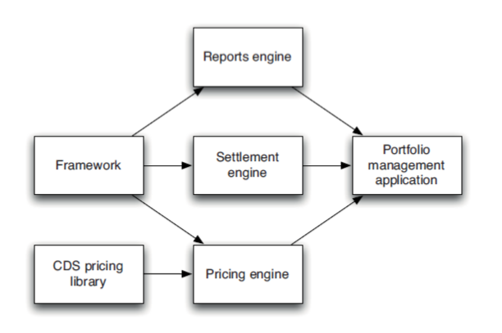
Managing Component
Building Dependency Graphs
credit default swap (CDS) library that is provided by third party

Slide 15
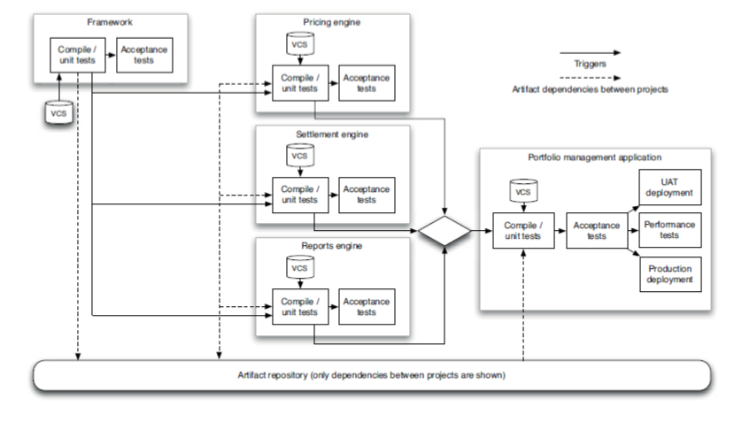
Managing Component
Pipelining Dependency Graphs

Slide 16
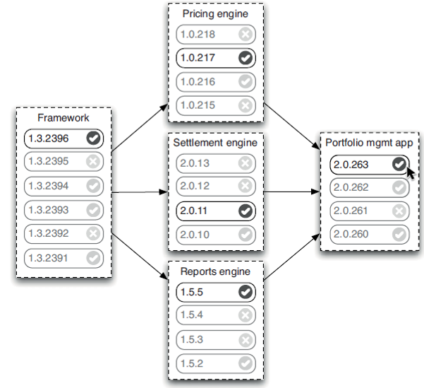
Managing Component
Pipelining Dependency Graphs Contd..
Visualizing upstream dependencies

Slide 17
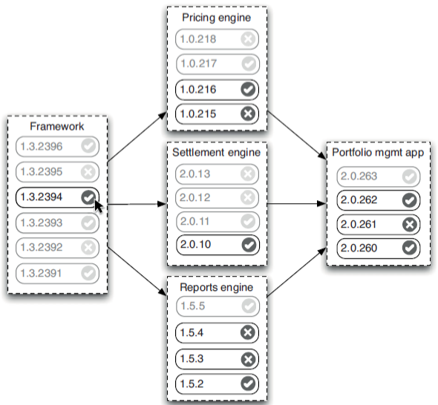
Managing Component
Pipelining Dependency Graphs Contd..
Visualizing downstream dependencies

Slide 18
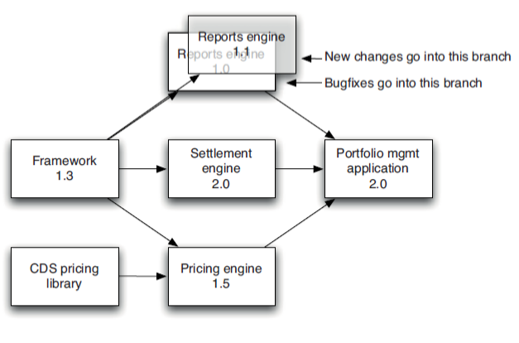
Managing Component
Pipelining Dependency Graphs Contd..
Branching Components

Slide 19
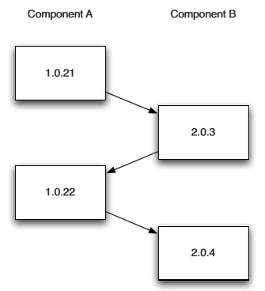
Managing Component
Circular Dependencies
This occurs when the dependency graph contains cycles
The simplest example is that you have a component, A, that depends on another component, B, unfortunately component B in turn depends on component A
to survive this problem so long as there is a version of component A that you can use to build component B then use the new version of B to build the new version of A
This results in a kind of “build ladder”
No build system supports such a conﬁguration out of the box, so you have to hack your toolchain to support it.
also have to be cautious in how the parts of your build interact
Circular dependency build ladder

Slide 20
Thank You!
In our next session:

